Slide 1
Cell morphology and aging
20180906
Yihong Wu (exp. 血管平滑肌細胞)
Notes:
表格化(包含各篇論文內的cell lines、確定老化的分子數據或方法、觀察的morphology changes、老化的相關分子數據)、先看細胞株的樣子、可能可以看得特徵：細胞的3D、厚度、細胞的縱切面曲度、細胞核形狀、細胞形狀、細胞大小、各種面積

Slide 2
Morphology changes of interest
Mitochondria: rapid fission (Bossy-Wetzel, Barsoum, Godzik, Schwarzenbacher, & Lipton, 2003)
Nucleus: nucleus architecture in HGPS cells (Haithcock et al., 2005)
Changes of nuclear shape
Loss of peripheral heterochromatin
“…reducing the level of lamin and lamin-associated LEM domain proteins leads to shortening of lifespan. ”
ROS burden: fluorescent ROS indicator dihydroethidium (DHE)

Slide 3
Morphology phenotypes of senescence/ aging
Aging
Mitochondria rapid fission (Bossy-Wetzel, Barsoum, Godzik, Schwarzenbacher, & Lipton, 2003)
Nucleus architecture in HGPS cells (Haithcock et al., 2005)
ROS burden

Slide 4
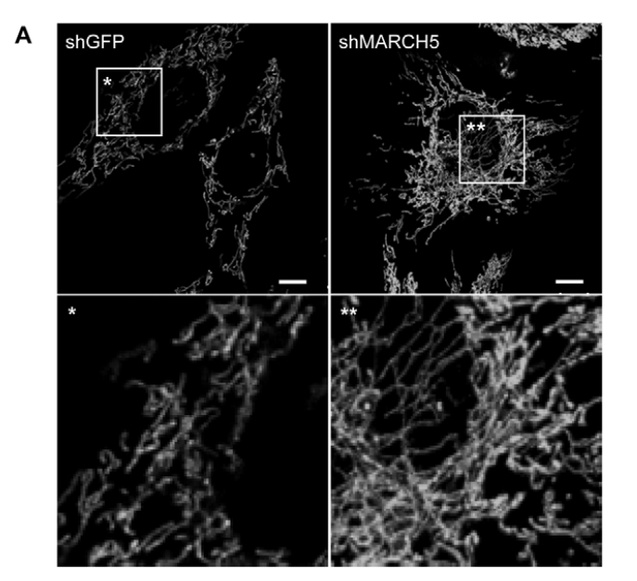
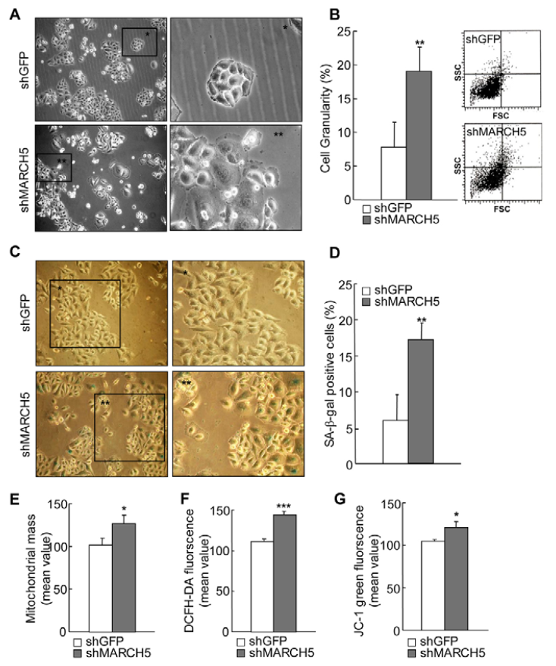
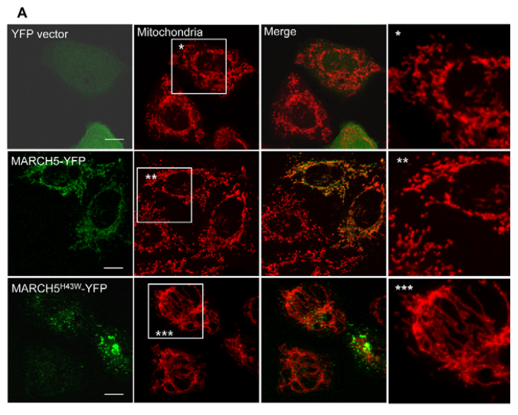
Morphology phenotypes of senescence/ aging
Senescence
(1) (Park et al., 2010)
MARCH5 knockdown→Mfn1↑→accumulation of highly interconnected and elongated mitochondria.
MARCH5 shRNA or RING domain mutant→cellular enlargement and flattening accompanied by increased senescence-associated β-galactosidase activity.

Slide 5
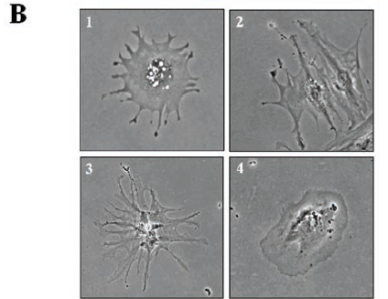
Morphology phenotypes of senescence/ aging
Senescence
(2) (Cho, Ryu et al. 2004)
Senescent diploid cells have a flat large shape.
The relationships between integrins, focal adhesion complexes, and small Rho GTPases with caveolin-1:
integrin β1 and FAK ↑
FAK and paxillin phosphorylation ↑ → Focal adhesion formation
Rho GTPases Cdc42 and Rac1 highly activated
Focal adhesion complexes and Rho GTPases ↑ in caveolin-rich membrane domain in senescent cells.
Activated Rac1 and Cdc42 directly interacted with caveolin-1.
Caveolin-1 knockout → young cell-like small spindle shape.
Senescent cells showed irregular large flat shapes versus young cells and increased levels of focal adhesion, lamellipodia, and filopodia (Fig. 1B).

Slide 6
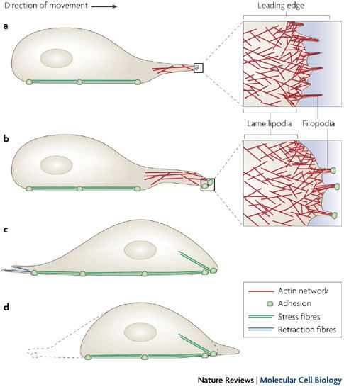
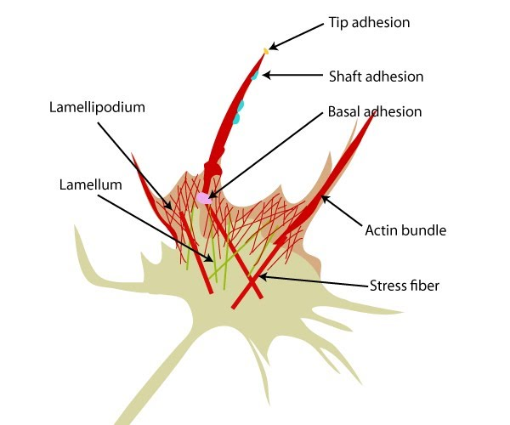
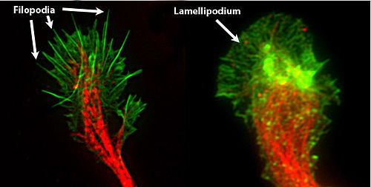
Lamellipodia v. Filopodia v. stress fiber (Cho, Ryu et al. 2004)

Slide 7
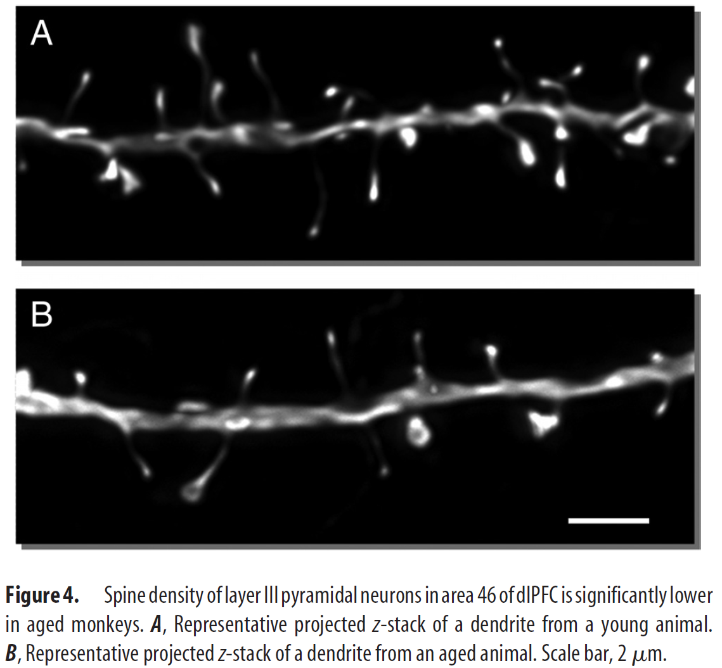
Arising questions: 1. Are different types of receptors involved in cell aging? (Dumitriu et al., 2010)
Methods:
Spine head volume/diameter

Slide 8
Potential obstacles:
1. Uncertainty of the viability to quantify.
2.

